Slide 1

Emotion classification model
Zakariae El Moumni
226324
1st year ADSAI

Slide 2
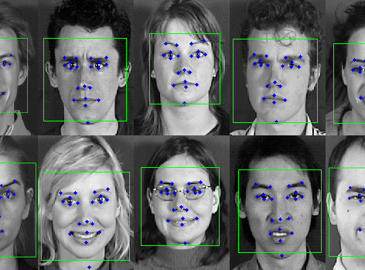
Introduction
Understanding emotions is crucial for AI. This presentation explores my process of building a classification model to classify emotions. It will cover the processes for data collection, feature engineering, and model evaluation that were used in the project .

Slide 3

Data collection
Utilized images from the FER-2013 dataset to establish a foundational dataset.
Incorporated the FER PLUS dataset to enhance annotation accuracy and detail.
Developed a custom web scraper to gather images from sources like DuckDuckGo.
Compiled a dataset rich in real-world facial expressions, and stock images ensuring robust model training and generalization.

Slide 4
Preprocessing
In the step of preprocessing the data that was collected, many preprocessing methods were used such as :
Resizing
Grey-scaling
Normalization
Regularization
Data augmentation

Slide 5
Model Architecture
Input layer: Convolutional (32)
Each choice in the architecture influences how the model learns and generalizes patterns from the data, ultimately shaping its ability to accurately classify unseen samples. Through this crucial process , and after trying out many different architectures and monitoring the accuracy I made a tailored architecture to tackle the classification task at hand, aiming to achieve optimal performance and robustness in my model.
Output layer : Dense(7)

Slide 6
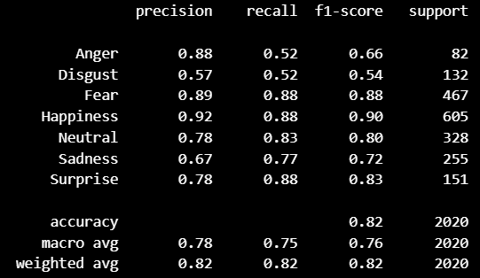
Model evaluating
Model evaluation is the critical process of assessing the performance and effectiveness of a trained machine learning model. It involves testing the model on unseen data to measure its ability to generalize to new instances accurately , in my case I have used: Precision , Accuracy and recall on every class ,and received the results shown in the picture .

Slide 7
Opportunities and Challenges
Opportunities and use cases :
Analyzing customer sentiments towards products/services through emotion detection in feedback and social media posts .
Powering sentiment-based recommendation systems to enhance user engagement and retention .
Challenges :
Ensuring the model's accuracy and reliability in accurately detecting subtle nuances of human emotions .
Handling the scale and variety of data sources, as well as the need for continuous model training and adaptation to evolving language and sentiment trends .

Slide 8
Conclusion
In conclusion, while the classification model presents promising opportunities for understanding customer sentiments and enhancing user experiences, it also faces challenges in ensuring accuracy and scalability. However, with diligent refinement and adaptation, the model holds the potential to drive innovation and success in the market landscape.
By addressing the challenges mentioned before and leveraging the model's capabilities effectively, businesses can gain a competitive edge and foster lasting relationships with their customers.

Slide 9
DATA SOURCES
Web scraper: https://github.com/BredaUniversityADSAI/2023-24c-fai1-adsai-ZakariaeElmoumni226324/blob/main/Deliverables/W1-RESPAI-Webscraper-Student-Notebook.ipynb
FER-2013. (2020, July 19). Kaggle. https://www.kaggle.com/datasets/msambare/fer2013
FER PLUS. (2024, April 4). FER PLUS - 3rd Feb. Kaggle. https://www.kaggle.com/code/farneetsingh2/fer-plus-3rd-feb/input

Slide 10
THANK YOU FOR your attention

